Slide 1
Team Verse
Final Presentation
Travis, Asher, and Jase

Slide 2
Team Members and Contributions
Travis
Team Leader, Designated Solder Expert
Asher
Main Coder, Voted Most Likely to Smash the Robot
Jase
Assistant, Assembler, Parts Organizer

Slide 3
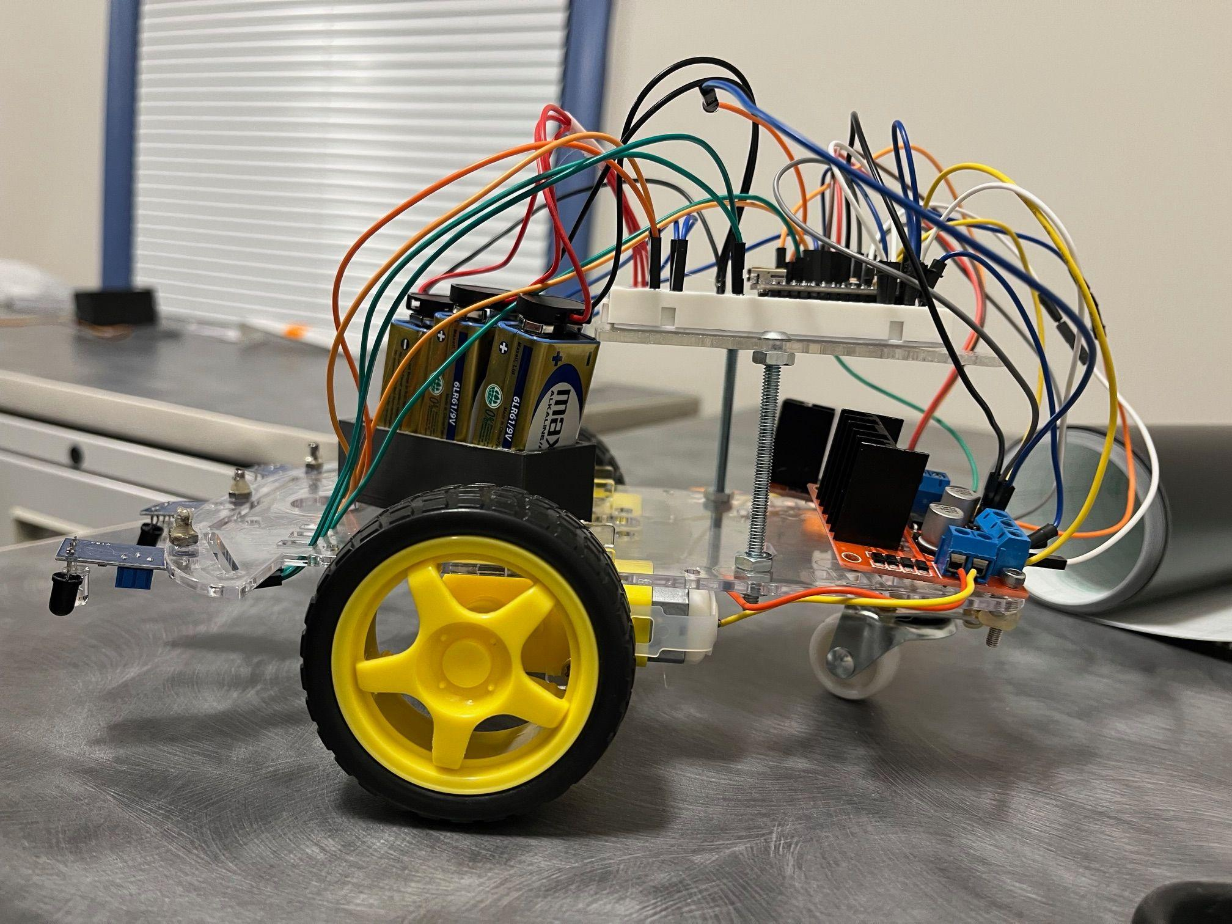
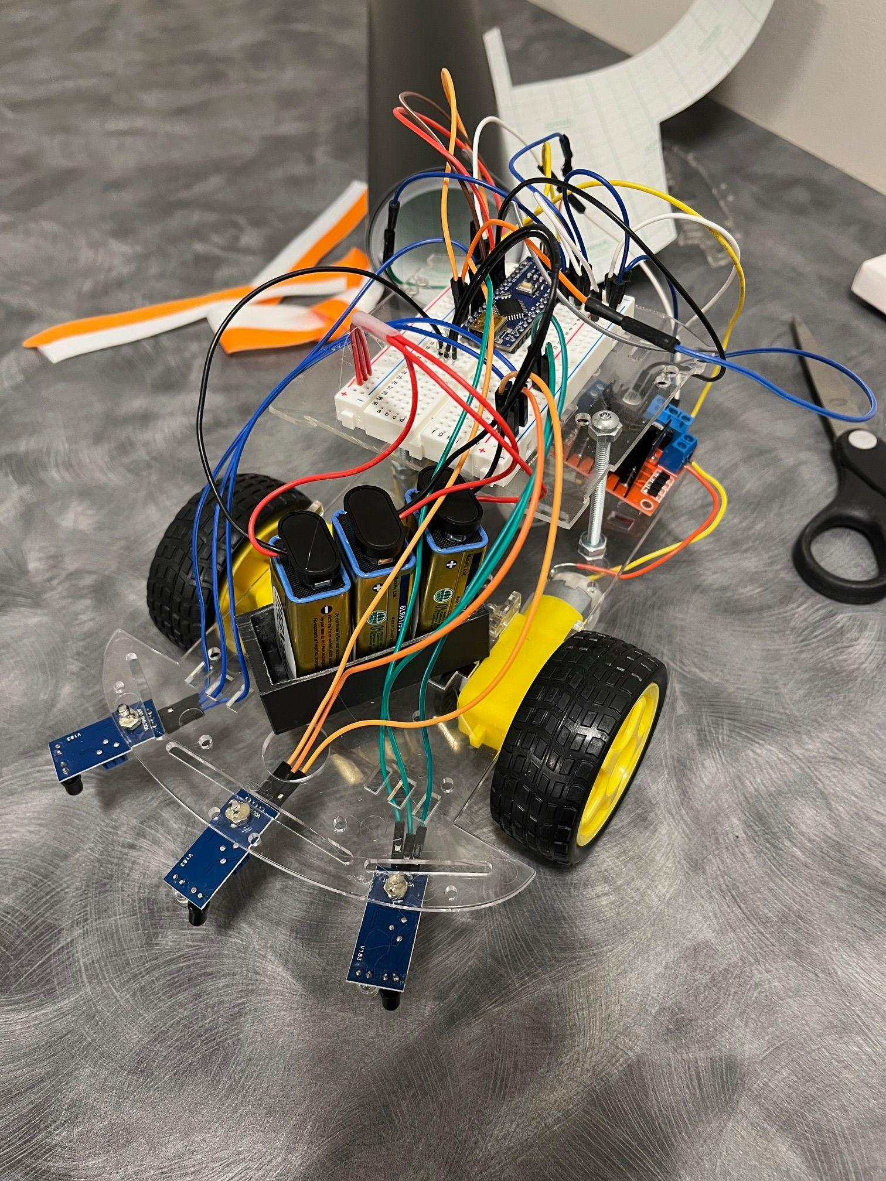
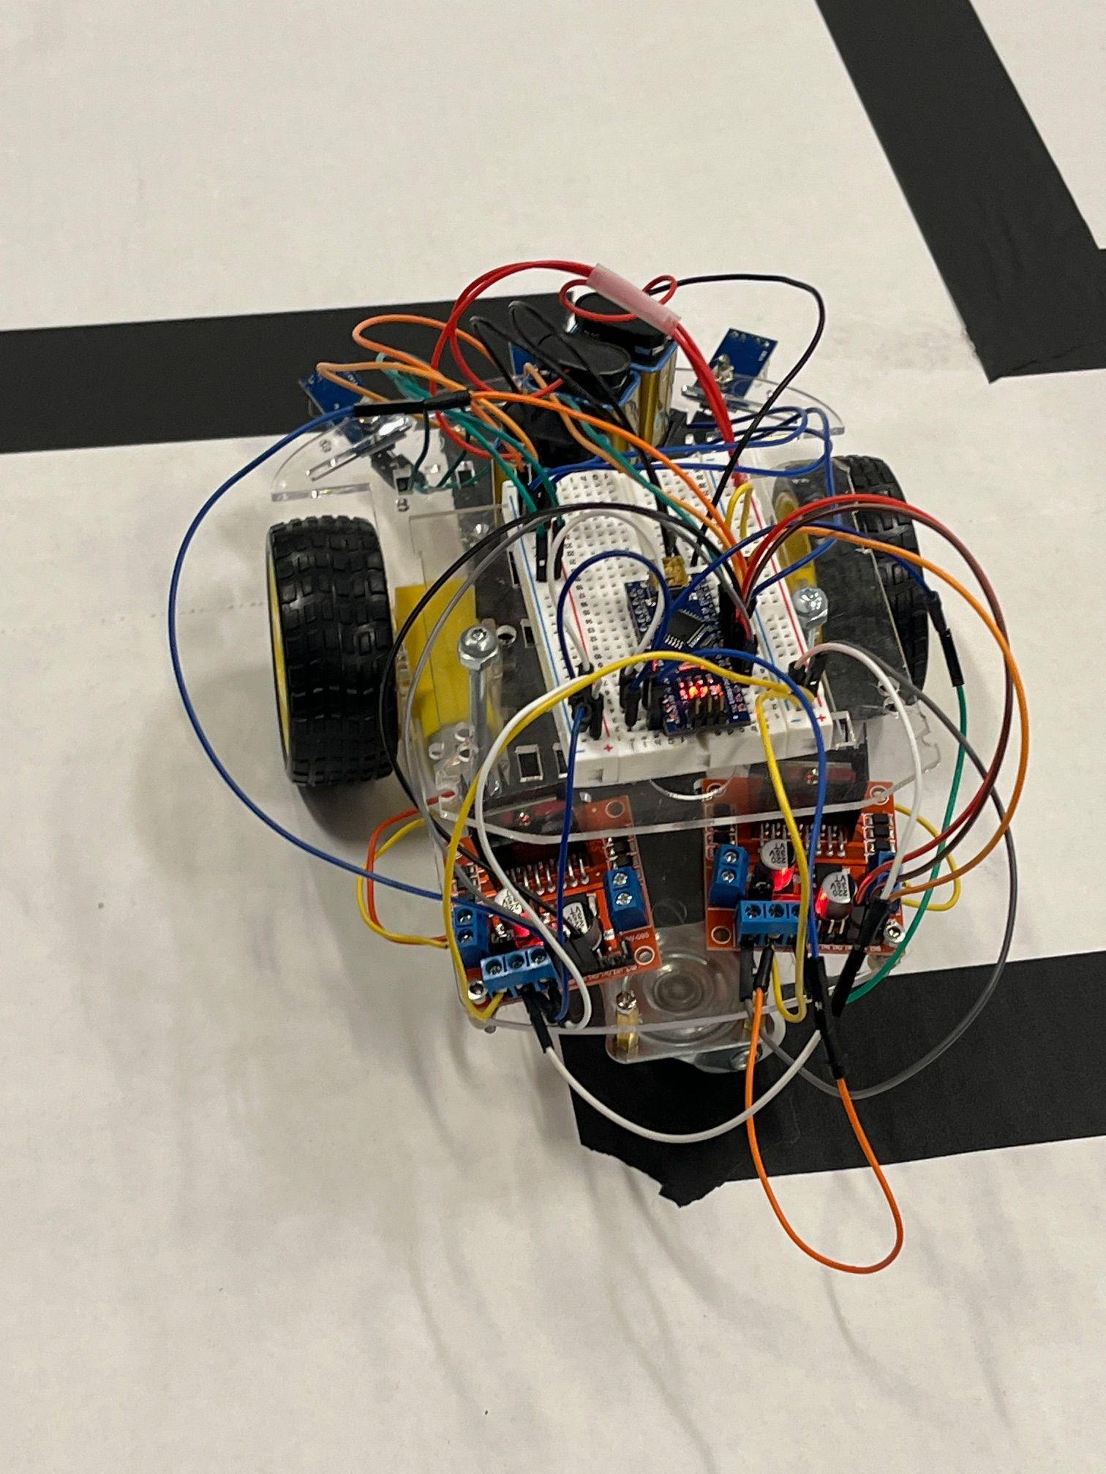
The Robot (RSM, Rarely Solves Mazes)
Designed to solve a maze, (black pathing/white background)
Components:
1.5 Plastic Chassis
Infrared Line Sensors
Two DC Motors & Wheels
Tailfin Wheel
Two Motor Controllers
Battery Plate (3D Printed)
Nine-Volt Batteries and their connectors
Breadboard
Arduino Nano
Notes:
Travis talks about assembly

Slide 4
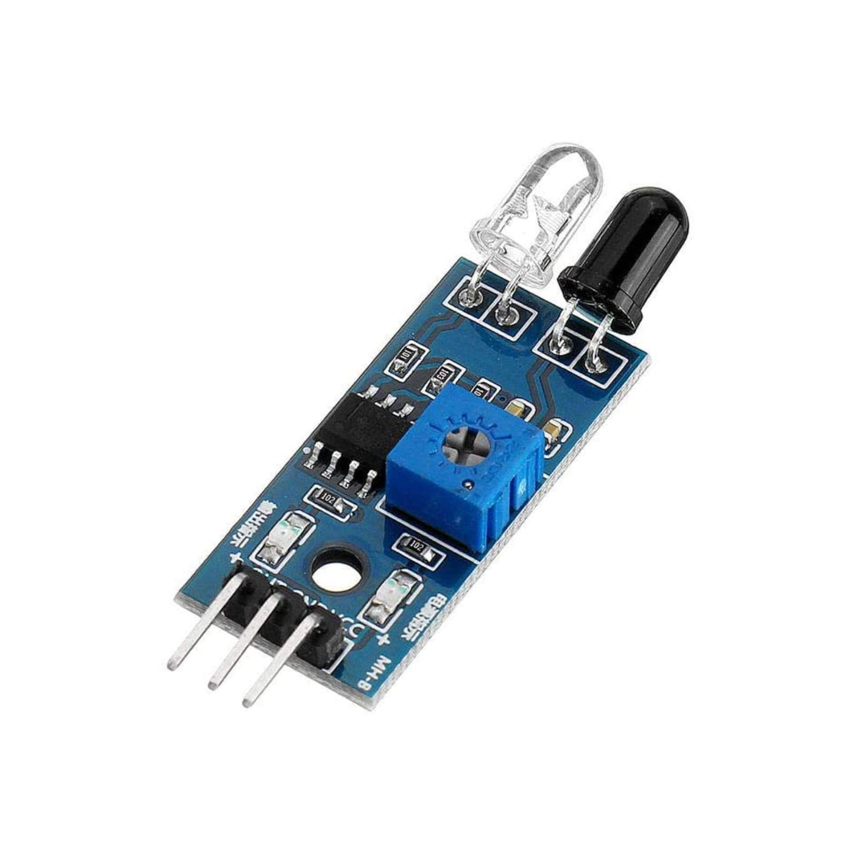
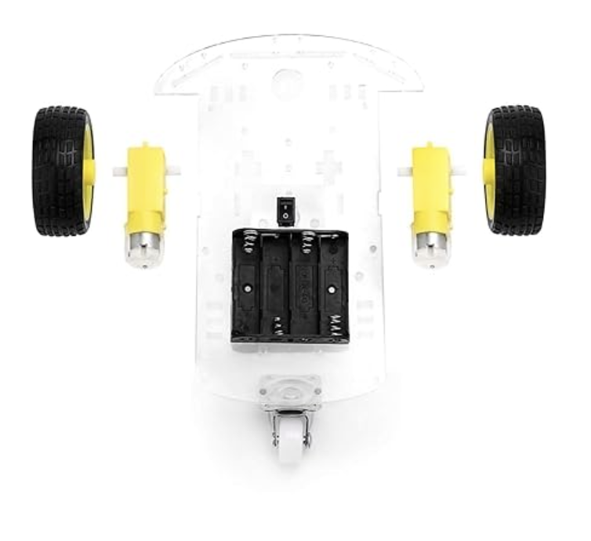
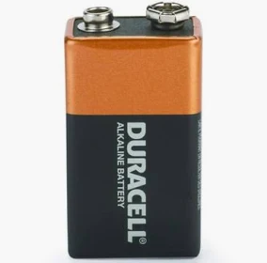
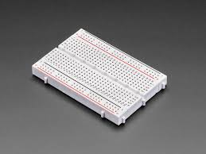
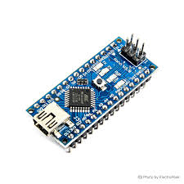
Hammerhead Design
Notes:
Travis

Slide 5
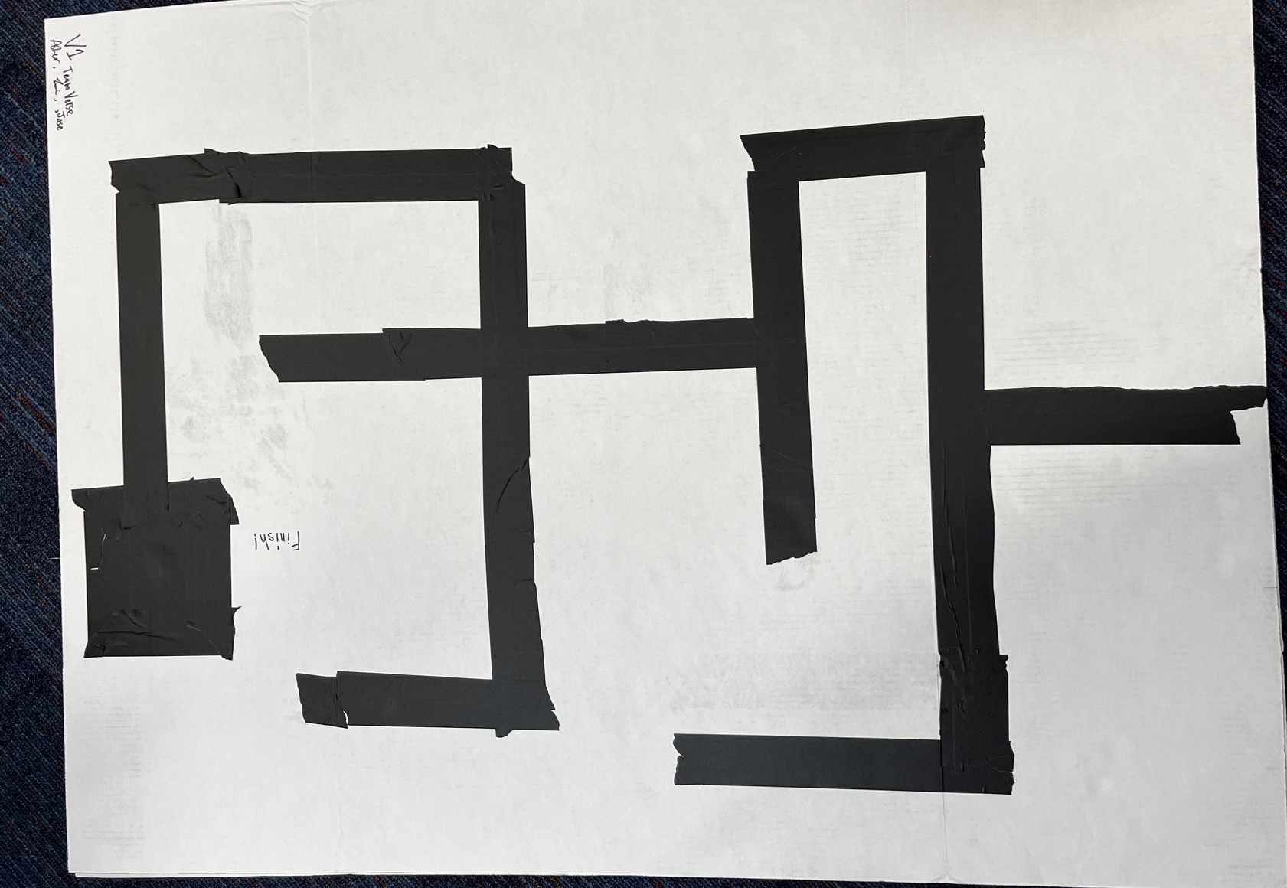
The Maze(s)
Made out of Poster Board and Masking Tape
Tape needs to be black so it doesn’t reflect the sensor’s signal.
The materials allow us to try a near-infinite amount of combinations and paths… As long as we have enough tape.
Notes:
Jase

Slide 6
Algorithm/Code
Maze-solving implemented using the left-hand rule
Each movement is done by turning the wheels for a fraction of a second
Needed to account for a power differential in the wheels
Right wheel was stronger, causing RSM to veer to the left
Function to reorient RSM on the line based on last command

Slide 7
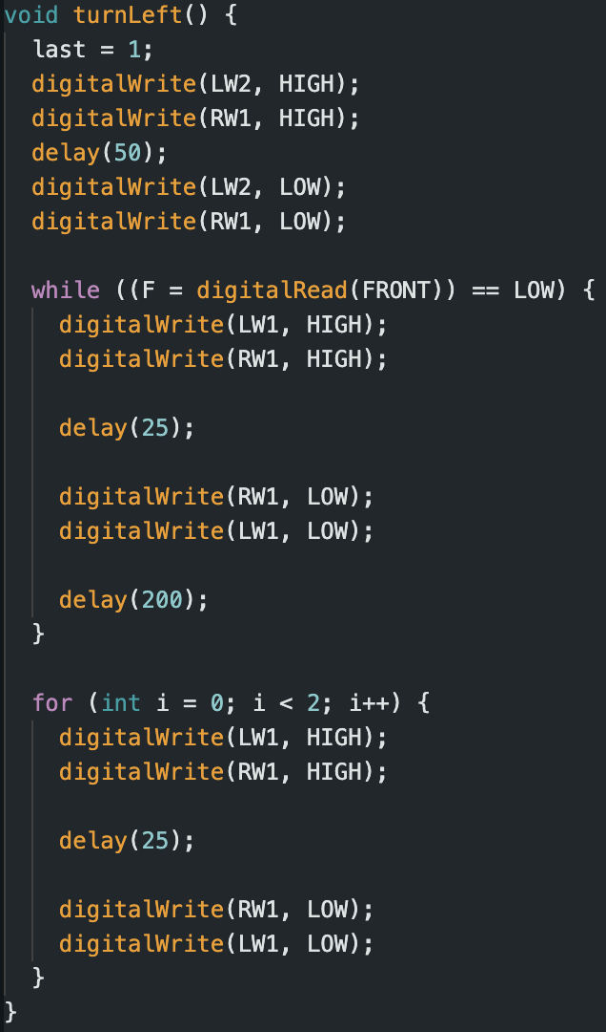
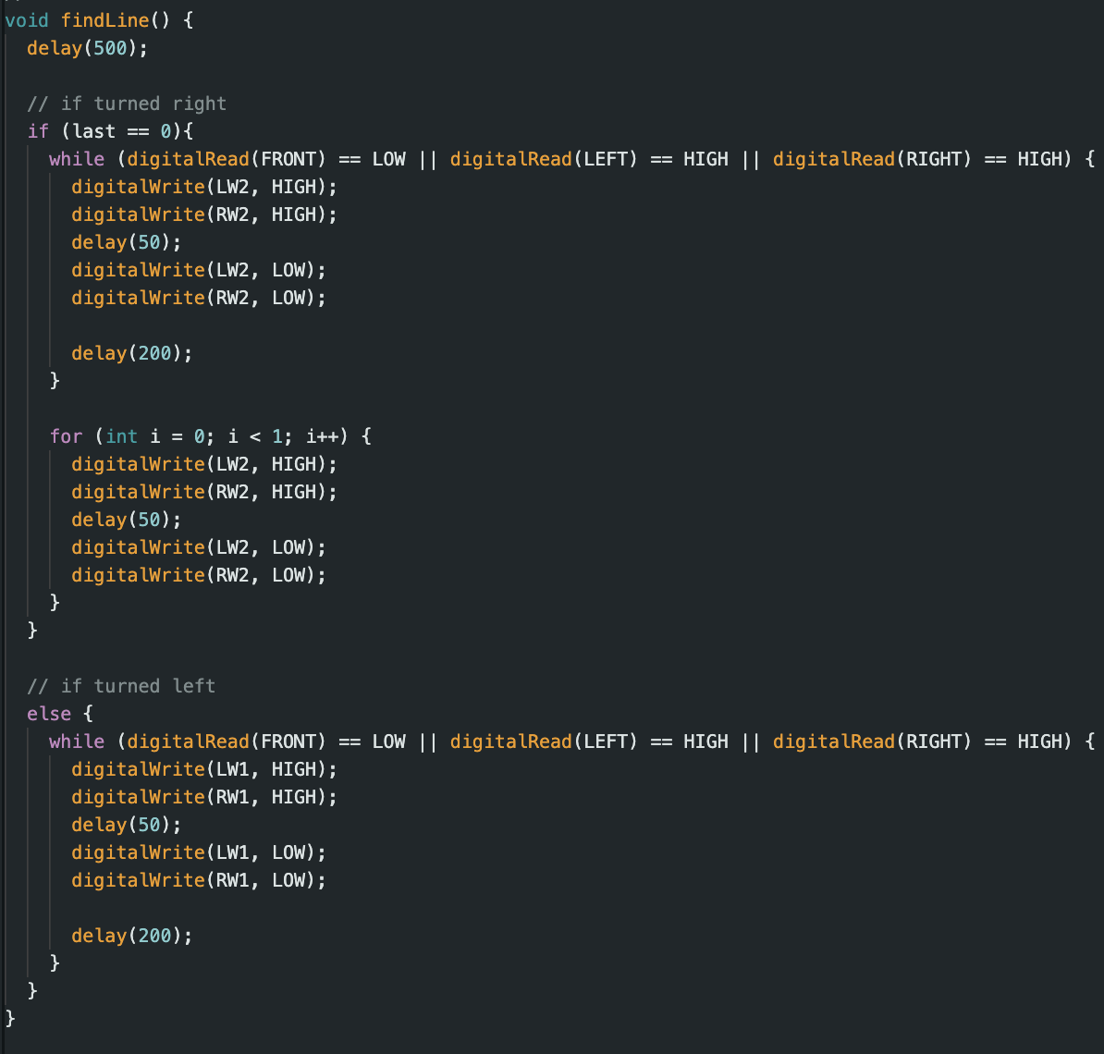
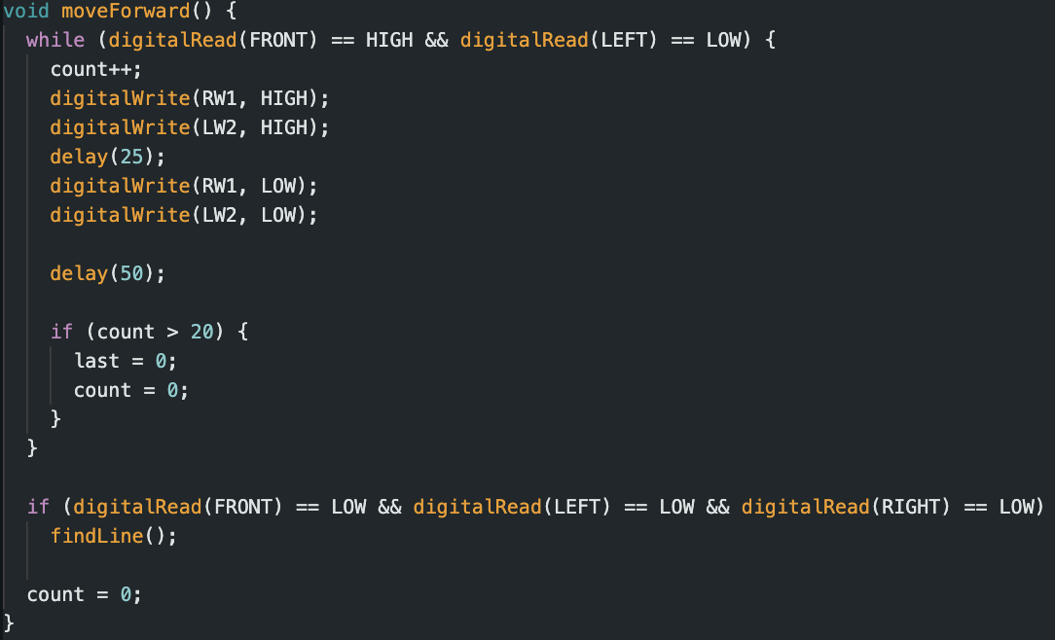

Slide 8
Reaching the End
Identical situations for the end of maze and a ⟂ intersection
Move forward and read sensors again
If all are still active– end of maze reached

Slide 9
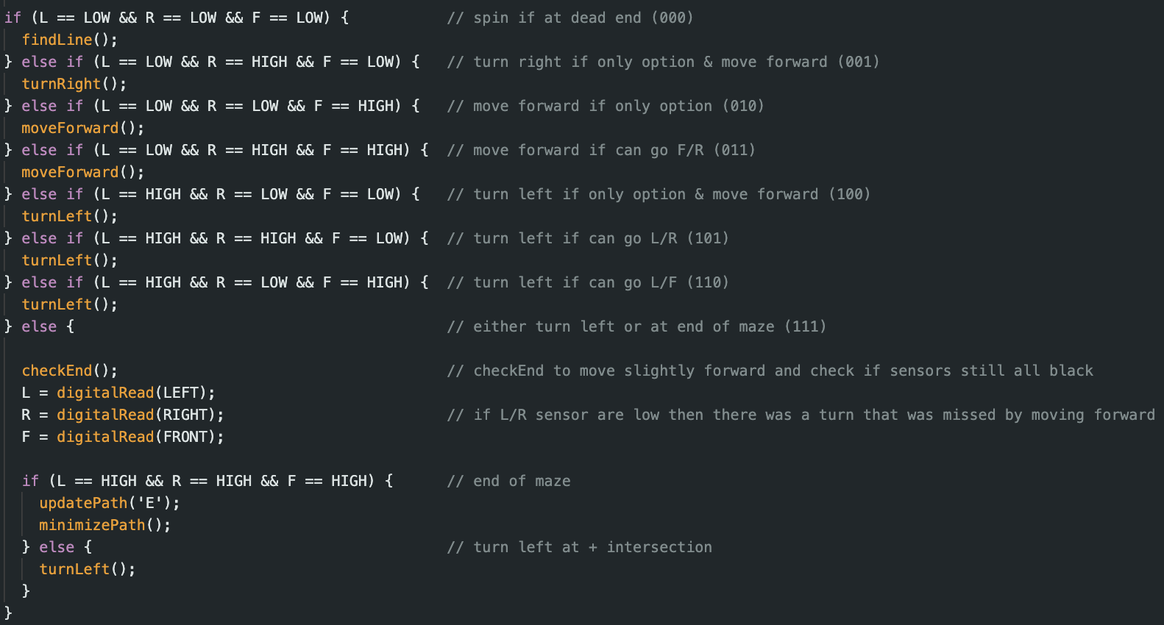

Slide 10
Path Minimization
Built a path array that stores each movement taken
At the end, uses the rules to create an optimal path
Repeats the maze following the simplified version
LBR → B
LBF → R
RBL → B
FBL → R
FBF → B
LBL → F

Slide 11
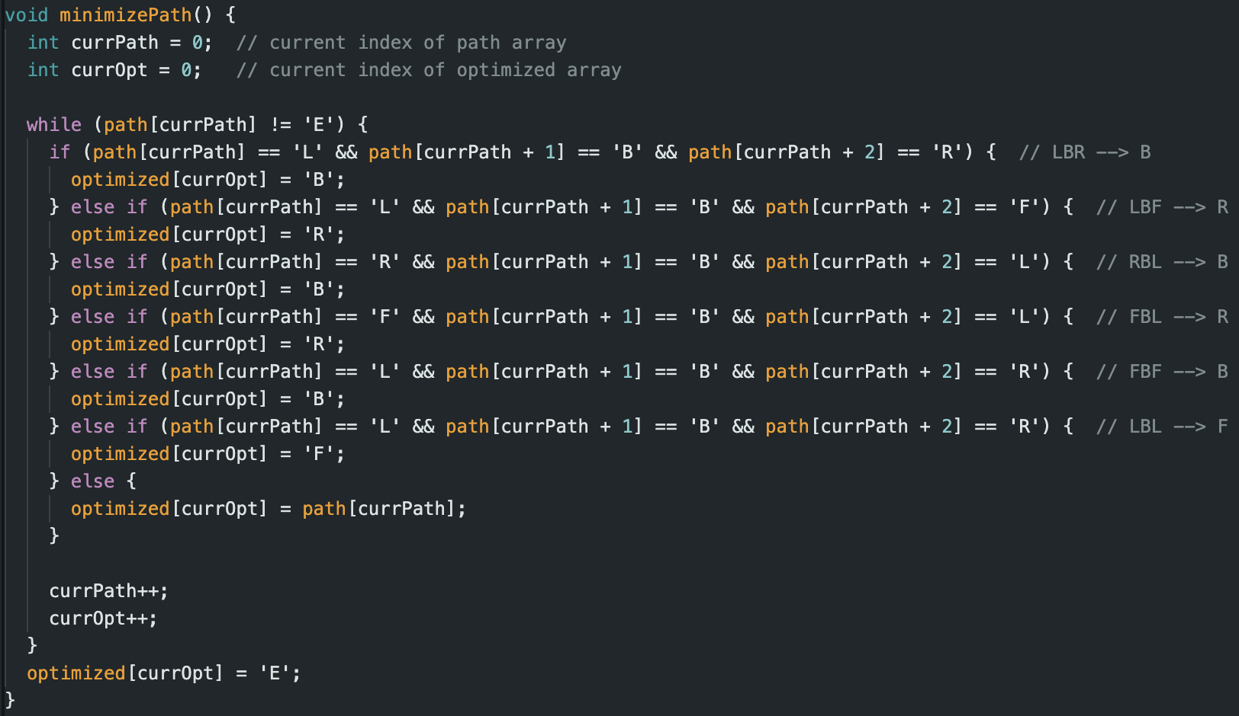

Slide 12
Challenges
Initial motor control
Using the kit batteries
Repeat soldering
Power differential in wheels
RSM did not always get enough power to run
Kept changing movement durations to combat different speeds

Slide 13


Slide 14

Notes:
Questions Slide

Slide 15


Slide 16
Sources
End of maze - https://www.hackster.io/Varun2905/maze-solving-robot-3-ir-sensors-9ada3b
Path minimization - https://patrickmccabemakes.com/tutorials/Maze_Solving/

